Slide 1
AI-Embedded Virtual Personal Trainer
Group -8
Himaja Boinapally-11699781
Jyothika Raj Samineni-11591327
Lakshmi Surekha Maddukuri-11668798
Vineela Reddy Sirasanambeti-11568122

Slide 2
Outline
Introduction
Problem Statement
Workflow
Architecture
Dataset
Data Preprocessing
Implementation
Results
Project Management
References

Slide 3
Introduction
Growing attention to health and fitness in our fast-paced culture has created a need for individualized solutions.
Yet many people do not have the time or resources to address this issue, therefore creative and practical solutions are needed.
In order to enable users to attain their fitness and health objectives by making well-informed decisions and improving their general well-being, our project aims to create a virtual personal traine .
We uses Natural Language Processing (NLP) and Artificial Intelligence (AI) to present tailored diet and exercise recommendations.

Slide 4
Introduction
Our project's strength is its capacity to reach a wider audience regardless of location or socioeconomic status through fitness coaching
The main goal is to create a simulated intelligence-powered virtual fitness coach that can identify and cater to the individual demands, dietary preferences, and health goals of every customer.
This endeavor's timely response to the changing health and well-being landscape, with its goal of improving lives and democratizing expert fitness coaching, highlights its significance.

Slide 5
Problem statement/Hypothesis
The hypothesis is to close the accessibility gap to customized fitness solutions that meet a range of individual needs and lifestyles by utilizing Natural Language Processing (NLP) and Artificial Intelligence (AI).
The technical part of our project lies in extracting the data from the pdf and using various libraries and dividing the text into small overlapped chunks and provide answers to the users in a relevant way.
The significance of our project lies in breaking of pdf into chunks and generate embeddings for comparison, and give informative responses to user questions based on the content of the documents.

Slide 6
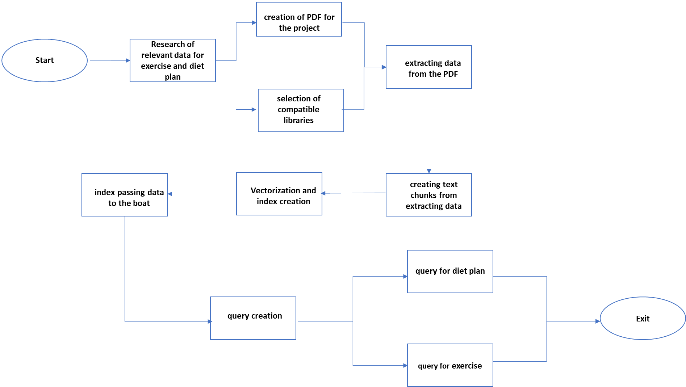
Workflow

Slide 7
Workflow
Creating the data in the form pdf by collecting the data related to the exercise and diet plans from various sources.
In the next step we will select the libraries that are used in the project and compare with the other relatable available libraries and choosing the best with high accuracy.
Downloading and Initializing the required libraries.
Now we will upload the created pdf and extract the data from pdf.

Slide 8
Workflow
The extracted data will be now separated into chunks to enable the bot for better results.
In the next step we will be creating the vectors for the split chuck data.
In the index creation we will be creating a vector store and database which will support similarity search.
Initializing the bot with the created vector database.
The UI is created to ask the queries related to the exercises and diet plan.
The top three most relevant answers are provided.

Slide 9
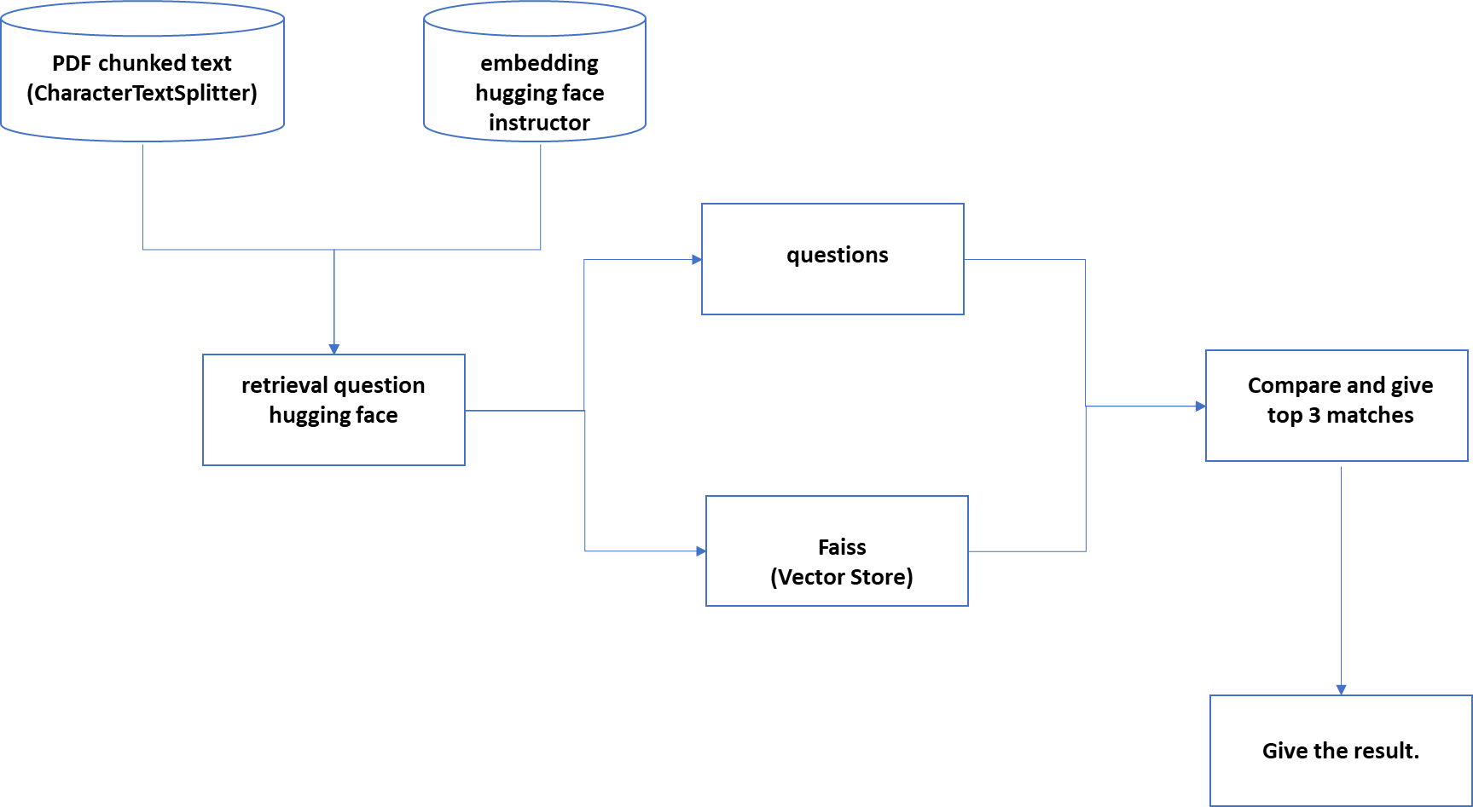
Architecture

Slide 10
Architecture
Grabs text from PDF files using PyPDF2.
Breaks down the large text into smaller, overlapping chunks. It helps in handling large amounts of information more efficiently using CharacterTextSplitter
Using HuggingFaceInstruct these chunks into a form a system can understand which is called embedding.
Organizing these chunks and comparing with the FAISS database which is used to give top 3 comparing results.
After processing user queries, our model responds with answers obtained from the organized text chunks.

Slide 11
Dataset
Our project requires a dataset in the form of a word document or pdf format which consists of data related to exercise and diet plans.
So, we started researching for the best data that we can use to prepare the dataset in pdf format for our project.
After surfing various resources, we have gathered the best information on diet and exercise plans.
With the collected information we have created our own pdf file for our project.

Slide 12
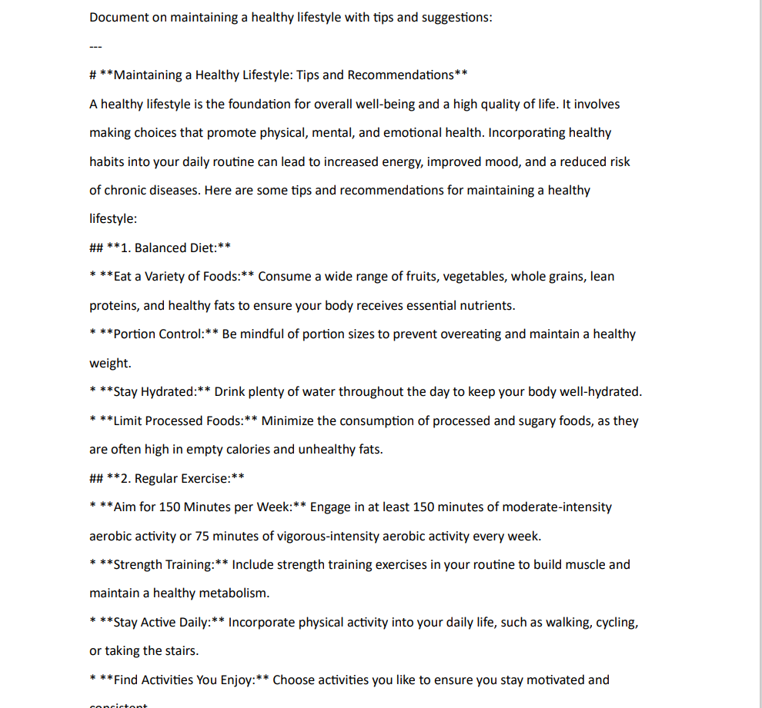
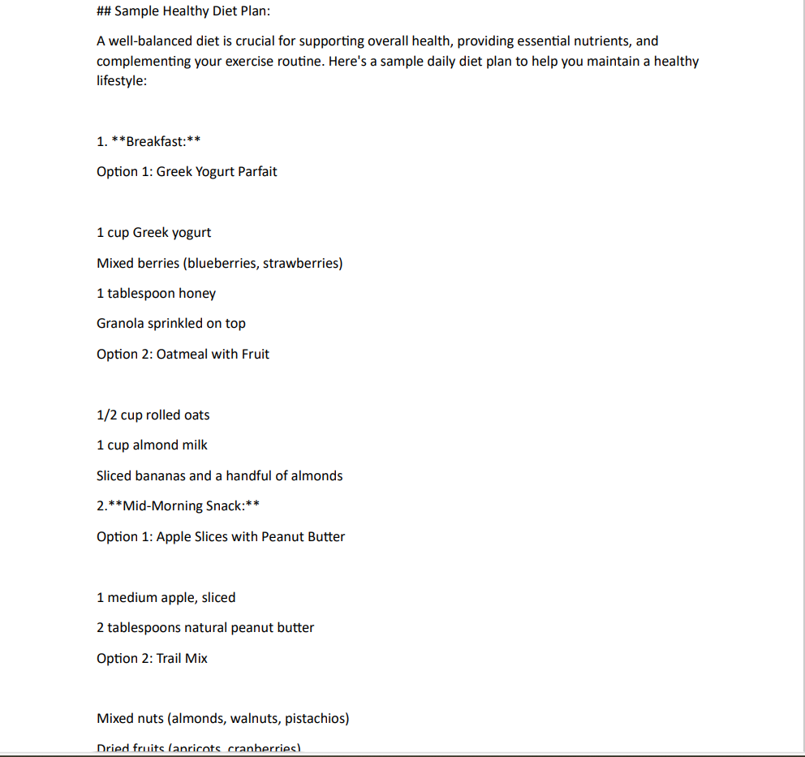

Slide 13
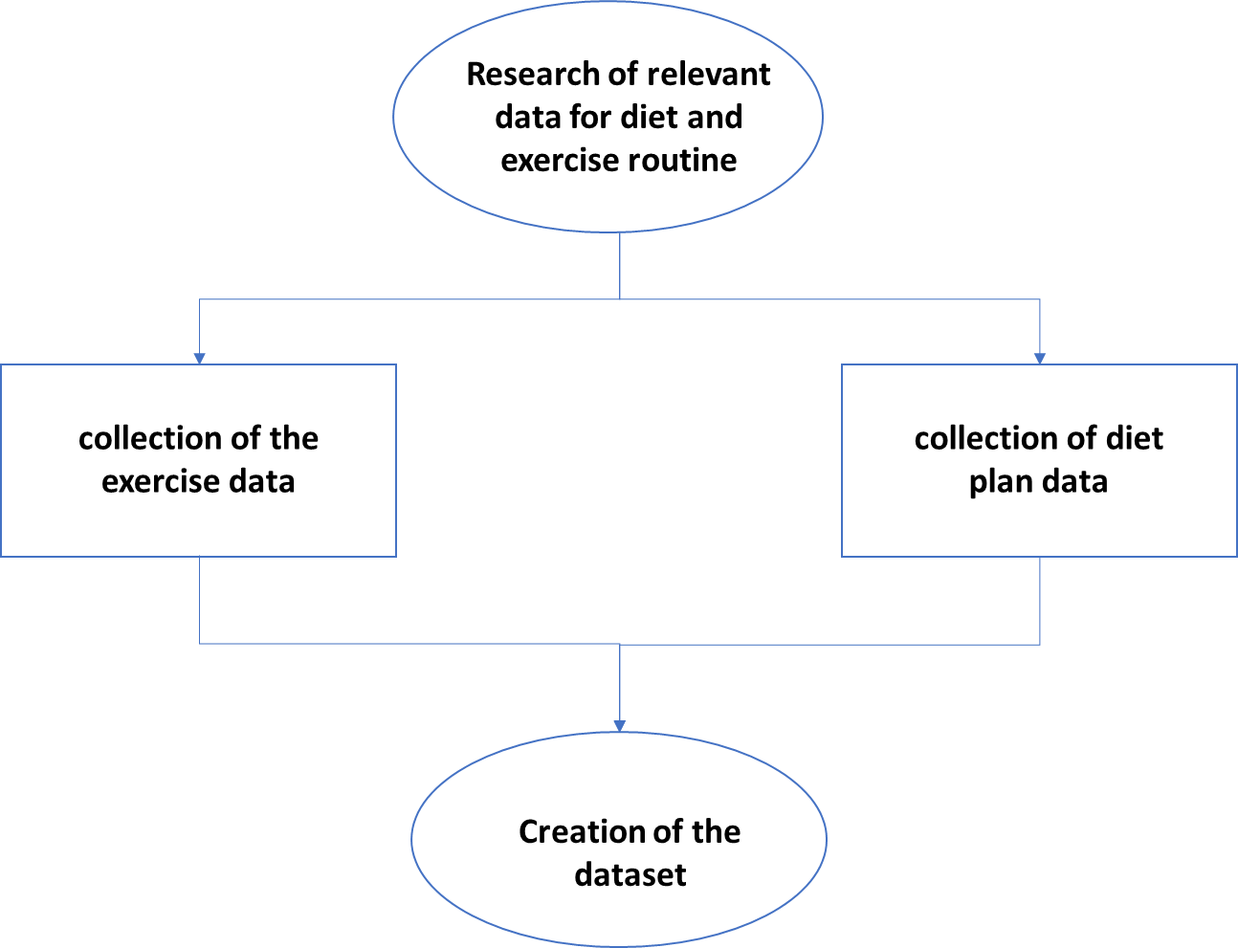
Dataset

Slide 14
Dataset
Dataset
Maintaining a Healthy Lifestyle
Diet Plan
Exercises
Balance and Coordination Exercises

Slide 15
Dataset
Maintaining a Healthy Lifestyle: Tips and Recommendations:
Gives general suggestions on maintaining a healthy lifestyle, covering aspects such as balanced diet, regular exercise, sufficient sleep, stress management, mental and emotional well-being, avoiding harmful substances, regular health check-ups, sun protection, hygiene, and maintaining a positive outlook.
Exercises for Overall Health and Well-being:
Lists different types of exercises categorized into cardiovascular (aerobic), strength training (resistance), flexibility and stretching, core strengthening, balance and coordination, high-intensity interval training (HIIT), and outdoor activities. The text emphasizes the importance of choosing enjoyable activities and considering individual fitness levels and health conditions.

Slide 16
Dataset
Diet Plan:
Provides a sample daily diet plan with options for breakfast, mid-morning snack, lunch, afternoon snack, dinner, and evening snack. The diet plan includes a variety of nutrient-rich foods, such as fruits, vegetables, lean proteins, and whole grains.
Balance and Coordination Exercises:
Balance exercises like heel-to-toe walks, single-leg stands, and one-leg balance with closed eyes can help tremendously. Furthermore, agility drills that emphasize rapid and accurate foot movements, like ladder, cone, and dot drills, improve coordination and responsiveness.

Slide 17
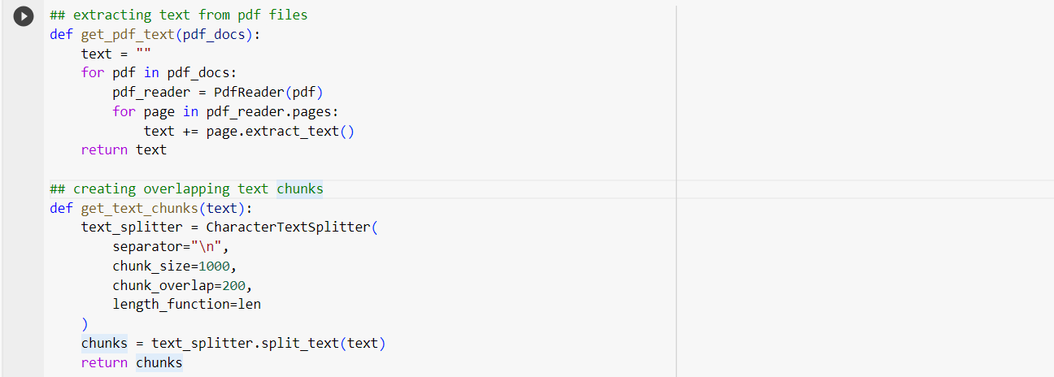
Data Preprocessing:
In the above code block we have used two functions to preprocess the data . The get_pdf_text function takes a list of PDF documents (pdf_docs) as input, iterates through the document, and extracts text from the document using the PdfReader from the PyPDF2 library.
The second function, get_text_chunks, takes a text string as input and uses the CharacterTextSplitter from the langchain library to segment the text into overlapping chunks of specified size.

Slide 18
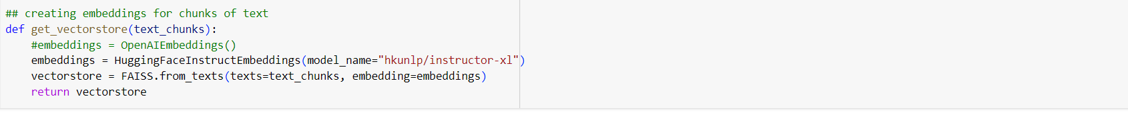
Get_vectorstore function turns pieces of text into numerical representations called embeddings. It uses a specific language model called "hkunlp/instructor-xl" to generate these embeddings, capturing the meaning of the text.
Then, it organizes these embeddings into a structure called a vector store using the FAISS library. This vector store allows for efficient searching and comparison of the embeddings, enabling tasks like finding similar text chunks based on their content.

Slide 19
Implementation
Algorithm/PseudoCode:
Step-1: Start
Step-2. Input PDF Documents
Step-3. Text Extraction using PyPDF2
Step-4. Text Chunking with CharacterTextSplitter
Step-5. Text Embeddings using HuggingFaceInstructEmbeddings
Step-6. Vector Store with FAISS
Step-7. Conversational Retriever using RetrievalQA Chain
Step-8. User Query Processing
Step-9. Answer Display
Step-10: Stop

Slide 20
Libraries Used:
PDFReader-providing functionalities to extract text content from PDF documents.
PyPDF2-for reading and manipulating PDF files in Python
InstructorEmbedding-provides pre-trained language embeddings, such as the Hugging Face Instructor XL
sentence_transformers-
generating embeddings from sentences, making it easy to encode and compare text representations.
Faiss-efficient similarity search and clustering of dense vectors
faiss-gpu-GPU-accelerated version of the library, enabling faster and more efficient vector similarity search
Langchain- library which is used for text splitting, embeddings, vector stores, and conversational models.

Slide 21
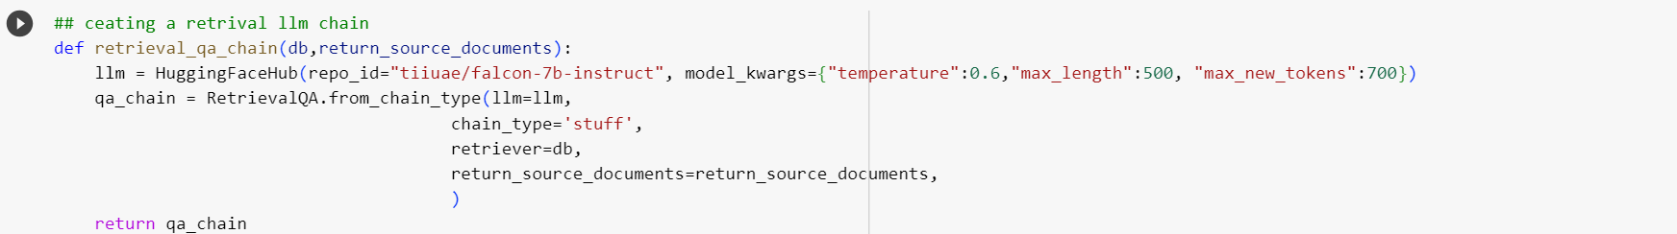
Explanation of implementation

Slide 22
After data preprocessing we will create the above function which creates a RetrievalQA model (qa_chain) for conversational question-answering.
It uses the Hugging Face language model (llm) for generating responses. using the specified repository ID ("tiiuae/falcon-7b-instruct") and model configuration parameters.
Hugging Face is a platform that hosts a wide variety of pre-trained language models, including popular models like BERT, GPT-3, and more. These models can be accessed and used for various natural language processing tasks, such as text generation, summarization, translation, and question-answering.
The model is configured with a temperature of 0.6, a maximum response length of 500 tokens, and a limit of 700 new tokens.
Adjusting the temperature of a language model alters the level of creativity and coherence in the generated text. Higher values foster more creative yet potentially erratic outputs, while lower values prioritize coherence but may lead to repetitive text.

Slide 23
By restricting the output to 500 tokens, we are not only controlling the length of the generated text. But also constraining the model's creativity to a certain extent, preventing it from producing an overwhelming or excessively verbose response.
The chain_type is set to 'stuff,' indicating a generic type suitable for various questions and answers.
The retriever database (db) is provided for similarity search.
The return_source_documents parameter is a boolean flag indicating whether the system should return source documents during the conversation.
The function returns the configured RetrievalQA model (qa_chain), which encapsulates the entire conversational question-answering system.

Slide 24
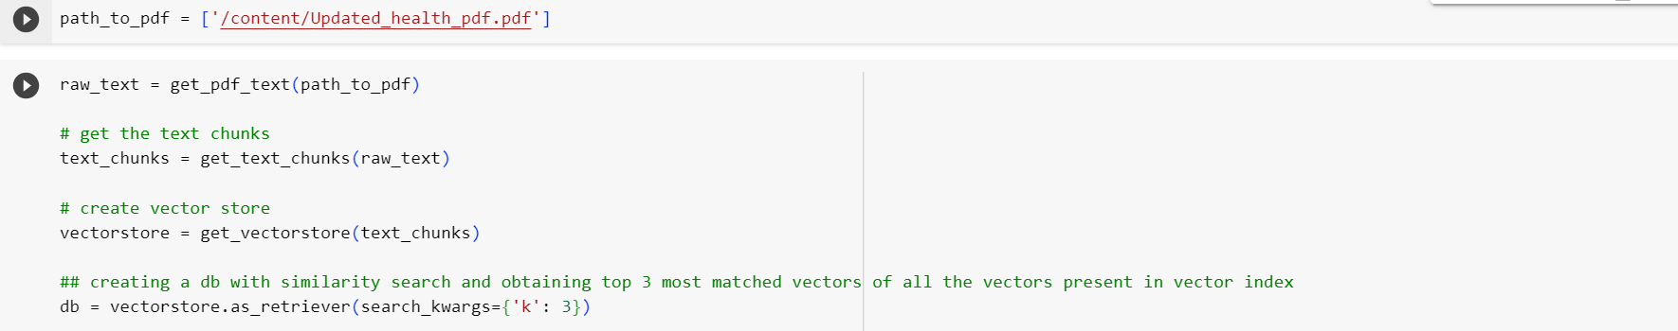
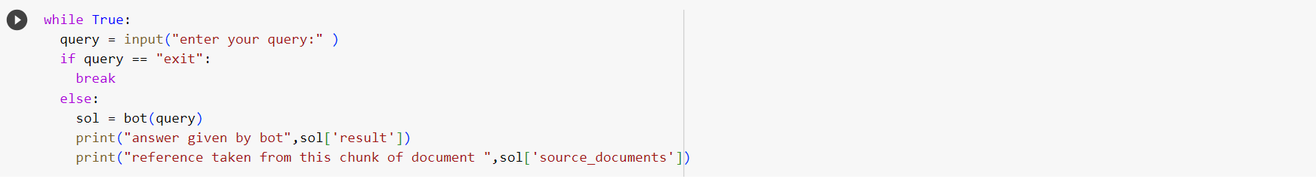

Slide 25
The get_pdf_text function extracts text content from the specified PDF document(s) stored in the path_to_pdf variable, resulting in the variable raw_text.
The get_text_chunks function divides the raw text into overlapping chunks with a defined size and overlap, creating a list of text chunks stored in the variable text_chunks.
The get_vectorstore function generates embeddings for the text chunks using a pre-trained language model (Hugging Face Instructor XL). These embeddings are used to create a vector store (vectorstore).

Slide 26
The vector store is converted into a retriever database (db) capable of performing similarity searches. The search_kwargs={'k': 3} parameter indicates that the system should retrieve the top 3 most similar vectors during a search.
The retrieval_qa_chain function initializes a conversational question-answering system using a Hugging Face language model and the retriever database. The True argument for return_source_documents indicates that the system should return the source documents during the conversation.
The code enters a loop where the user can input queries. If the query is "exit," the loop breaks; otherwise, the system processes the query using the initialized conversational question-answering system (bot). The system's response and the reference source documents are then printed.

Slide 27
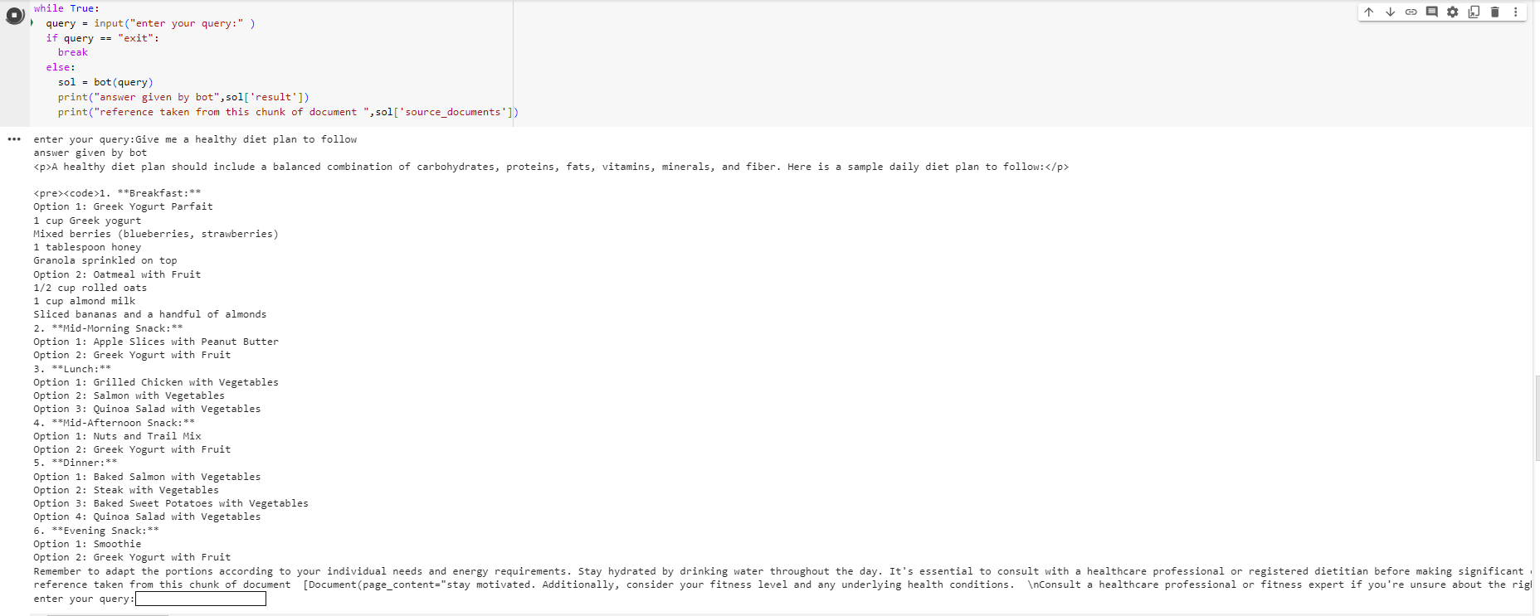
Results:
When we enter query to give the diet plan we get the result as below :

Slide 28
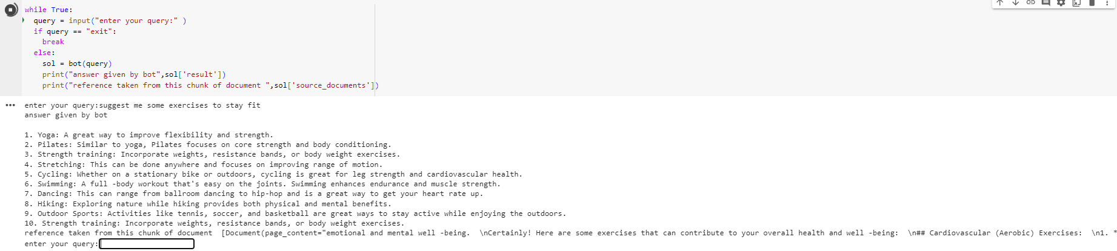
Result - 2 When I ask to suggest me exercises to stay fit it gives the following result

Slide 29
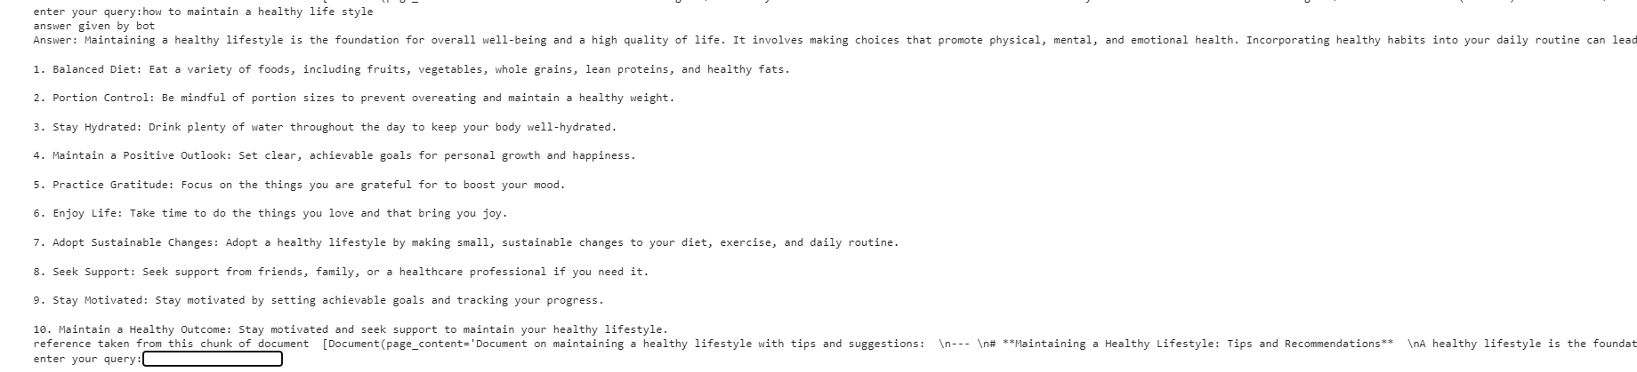
Result -3
When I ask how to maintain a healthy life style it gives the following result

Slide 30
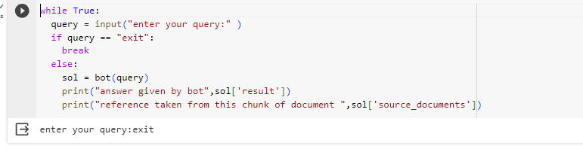
Result -4:
If we enter exit the bot stops executing and gets terminated.

Slide 31
Project Management:
The main work of our project lies on collection of data for the creation of dataset by surfing various sites and extracting useful information from them and preprocessing the raw data and for the implementation we have compared various language models and selecting the best language model for our implementation.
Member | Task Worked on | Contribtion
Himaja | Data preprocessing and chunk texts Data collection related to “for Maintaining a Healthy Lifestyles”s | 100% 100%
Surekeha | Creation of the vector space and the Large language model. Data collection related to “Diet plan” | 100% 100%
Vineela | Implementation of Data Vectorization And Index Creation. Data collection related “Exercise plan” | 100% 100%
Jyothika | Implementation of bot and the query processing part. Data collection related to “Balance and Coordination Exercises”. | 100% 100%

Slide 32
Github Link:
https://github.com/amarsree26/CSCE_5290--group-8-project

Slide 33
Zoom Link:
https://unt.zoom.us/rec/share/5L4uZvVOVI0485mm44P83U2mvyJsDpZrBm0GdkcasnAm96U-8UhD0d7ZlVXNGcfT.WFsQvvwu5VSPcqhP

Slide 34
References:
1) Topol, E. J. (2019). Elite execution medication: the combination of human and man-made brainpower. Nature Medication, 25(1), 44-56.
2) Goldberg, Y. (2016). An introduction to brain network models for normal language handling. Diary of Man-made Reasoning Exploration, 57, 345-420.
3) Vandelanotte, C., Müller, A. M., Short, C. E., Hingle, M., Nathan, N., Williams, S. L., and Lopez, M. L. (2016). Past, present, and fate of eHealth and mHealth exploration to work on active work and dietary ways of behaving. Diary of Sustenance Training and Conduct, 48(3), 219-228.
4) Prochaska, J. O., and Velicer, W. F. (1997). The transtheoretical model of wellbeing conduct change. American Diary of Wellbeing Advancement, 12(1), 38-48.
5) Jurafsky, D., and Martin, J. H. (2020). Discourse and Language Handling: A Prologue to Normal Language Handling, Computational Semantics, and Discourse Acknowledgment (third ed.). Pearson.

Slide 35
THANK YOU

